Slide 1

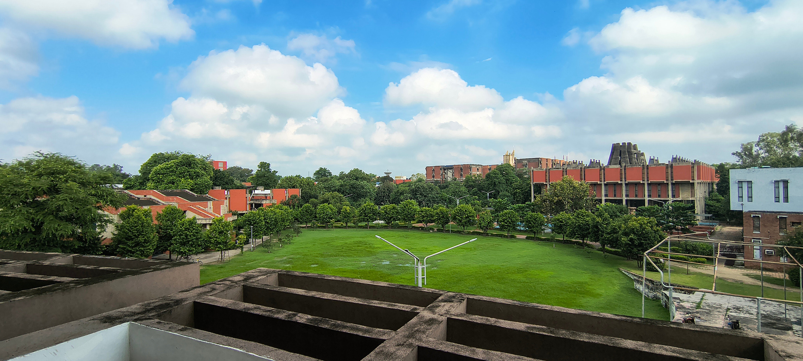

Team Kernel Panic
CS253 Project
IITK ProjectSpace
Github Repository

Slide 2
What problem does IITK ProjectSpace actually solve?
Projects and collaboration are an integral part of the IITK Community. Absolutely everybody takes part in projects, be it Professors, PhD scholars, PG or UG students. However currently, there is no particular way for the community to showcase their past projects or find collaborators for their future ones. IITK ProjectSpace solves this issue in the following ways:
Users can maintain a personal portfolio profile including details such as email, department, skills, personal bio, social links, etc.
Users can post projects and project recruitments with details such as title, rich text descriptions, domains, media, related links and team members.
Users can apply to project recruitments posted by professors, clubs or simply other users looking for collaborators on a project.
Team Kernel Panic

Slide 3
Requirements
User Profile as a Personal Portfolio
The webapp must allow the users to maintain a personal portfolio on their user profile.
This must include details such as, but not limited to, Name, Email, designation, department, degree, social links. A list of skills and domains related to the user. A personal bio section where the user is able to express their areas of interests and background.
The user profile should also list all the projects and project recruitments that the user is consensually a part of.
Team Kernel Panic

Slide 4
Requirements
Rich Project Showcase with Team members
The webapp must allow the users to post rich projects with details such as a title, short summary, rich-text description, and a list of relevant domains, media such as images, videos and PDFs.
The project page must link the owner of the post and other team members. It should display the details, markdown description and any relevant media, they uploaded.
Users must be able to comment on the project post with the functionality of users replying to comments and the ability to delete their comments.
Team Kernel Panic

Slide 5
Requirements
Project-Based Recruitment system
The webapp must allow users to create structured recruitment posts for projects.
This must include fields such as title, detailed description (markdown/plain-text), domains/tags, and prerequisites specifying required skills.
The system should allow users to attach relevant media and external links to provide additional context for the recruitment.
Users must be able to define eligibility constraints (such as allowed designations and departments) and add fellow recruiters to the post.
Team Kernel Panic

Slide 6
Requirements
Application & Selection Workflow
The webapp must allow users to apply to recruitment posts and enable recruiters to manage the selection process.
This must enable the users to submit applications to open recruitments, subject to eligibility constraints defined in the recruitment post.
Recruiters must be able to view a list of applicants, access relevant applicant details, and take actions such as accepting or rejecting applications.
The system should maintain the status of each application (e.g., pending, accepted, rejected) and notify users regarding updates to their application status.
Team Kernel Panic

Slide 7
Requirements
Search and Discovery System
The webapp must provide a unified search and discovery system for projects, recruitments, and users.
This must include a global search bar that allows users to query the platform using keywords or phrases, with support for relevant result retrieval.
The system should categorize results into projects, recruitments, and users, displaying them in a structured, card-based layout with key information such as titles, descriptions, and user details.
Users must be able to refine search results using filters such as domains, skills, designations, and departments to improve relevance.
Team Kernel Panic

Slide 8



Tech Stack
Frontend was created using Next.js and React to create a smooth, interactive user experience. We also used Tailwind CSS for styling to ensure that the platform looks clean and responsive on all devices.
Backend was built using Python. We used the FastAPI framework to create quick and efficient APIs that handle user requests, process logins, and securely send OTP Emails.
PostgreSQL was used to handle out database. Since our platform relies heavily on connections (such as linking users to their projects, recruitments and applications), this relational database made it easy to store and search data safely.
Team Kernel Panic

Slide 9
DEMO TIME
Team Kernel Panic

Slide 10
Future Plans
Adding visibility of posts (public / private)
Any member of the team shall be able to change the visibility of project and recruitments to be private or public. Only public projects and recruitments will be displayed on the homepage feed, in search results. When seeing another user’s profile, only the posts that the current user is a part of or are public will be visible. On one’s own profile, the user will be able to view all the posts, public or private.
More information linked with applications
The users will be able to attach their curated CVs and related remarks with their applications to recruitments. The recruiters would then be able to (in theory) make more informed decisions regarding acceptance and rejection of applicants.
Team Kernel Panic

Slide 11
Future Plans
Recruitment Tests
Instead of evaluating applicants on the basis of their profiles, the recruiters will also have the option to add tests for recruitments. When applying, the applicant will be prompted to take a test (objective / coding) designed by the recruiters. This will require integrating a test environment with the platform. The candidates who could not achieve a score more than a benchmark set by the recruiters, would be auto-rejected. The qualified candidates would be further evaluated by the recruiters.
Credential verification of user profiles
User profiles will be verified by some super user, against their data available in the IIT Kanpur databases. This needs to be done to make sure that a user is not pretending to be someone they’re not or have false credentials in their profiles.
Team Kernel Panic

Slide 12
Future Plans
Modification of Applications and Waiting lists
The recruiters will be able to modify the outcomes of applications. They could reject a previously accepted candidate, and vice versa. Additionally, they will be able to put some promising candidates in a waiting list. If the recruiter rejects a previously accepted candidate, the application of a candidate from the waiting list will be automatically accepted.
SPO Integration
Right now, SPO requires verification from different institute clubs / professors in order to verify whether a project done by a student is legitimate. By integrating SPO admins directly with the platform, they will be able to directly verify all the projects done by a user and who were the people involved in it.
Team Kernel Panic

Slide 13
Lessons Learnt
This is probably the most practical and hands on departmental course we have studied. It was mesmerizing to see a functional website built by just the ten of us.
We realized that software development is not only about writing code or debugging. During the 3 – 4 months that we worked on this project, we, more often than not found ourselves solving problems that had nothing to do with the technical aspect of the project.
Managing a team of 10 people made us realize that there will always be disagreements between team members. Nonetheless, we also realized that it is always possible to reach middle grounds where no one would feel unheard.
Time management played a vital role in the success of this project. Managing other heavy departmental courses such as CS220 and CS771 drove us to utilize our time and shift workloads accordingly in order to work in an efficient manner.
Team Kernel Panic

Slide 14
QnA TIME
Team Kernel Panic

Slide 15
THANK YOU

